Slide 1
Dutch traditions en holidays
1. Sinterklaas - St. Nicholas
2. Kerst - Christmas
3. Oud en nieuw – New year’s eve
4. Carnaval - Carnival
5. Pasen - Easter
6. Koningsdag- Kingsday

Slide 2
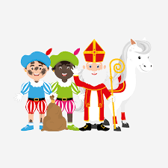
St. Nicholas
Made by:
Maud van Krevel,
Lizzy van der Heijden,
And Eva Uijen.

Slide 3
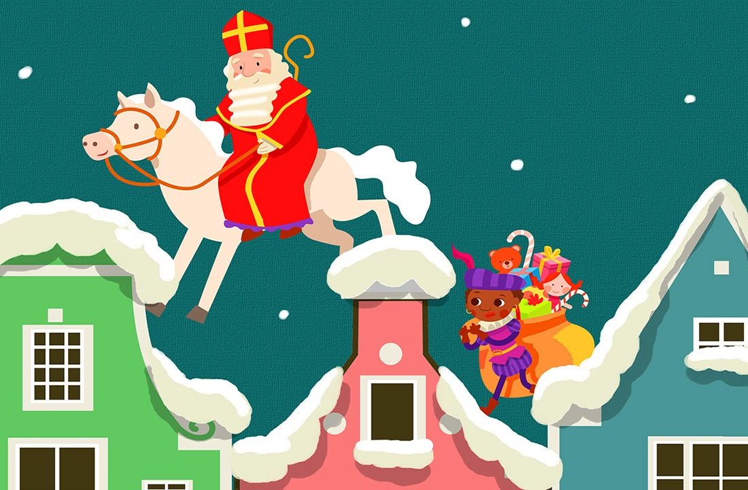
Table of contents
Introduction
St. Nicholas
St. Nicholas Helpers ‘’Chimney-Soot Helpers”
The fifth of December
The end

Slide 4
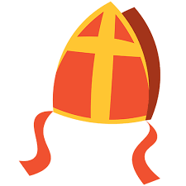
Introduction
Sinterklaas, better known as Saint Nicholas, is a Dutch tradition celebrated on December 5th with gifts, poems, and festive songs. Unlike Santa Claus, he arrives from Spain with a steamboat and celebrates his birthday by giving the nice children presents and taking the naughty children back to Spain.

Slide 5
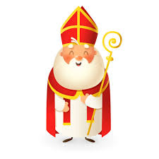
St. Nicholas
Sinterklaas is a traditional figure celebrated in the Netherlands on December 5th. Based on Saint Nicholas, he arrives from Spain on a steamboat, accompanied by his helpers. On ‘’Sinterklaas avond’’ (Saint Nicholas' Eve), children receive gifts and treats if they’ve been good.
Sinterklaas is depicted as an old man with a long white beard, a red robe, and a staff. He has a book with notes of how good the children have behaved during the year. The weeks that he is in the Netherlands before the fifth of December. The children can put out a shoe by the chimney with a list of the toys they want for Sinterklaas. And the St. Nicholas helpers wil collect the list and fill the shoe with a present, a chocolate letter of another sweet like gingerspiced cookies (pepernoten).

Slide 6
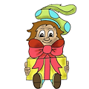
St. Nicholas Helpers ‘’Chimney-Soot Helpers”
Zwarte Piet, now often called "Roetveeg Piet" (Soot Smudge Helper), Traditionally, Zwarte Piet had a blackened face, but this has changed due to concerns about racism. The helpers with soot smudges, symbolizing climbing down chimneys to deliver gifts.
The Chimney-Soot helpers are St. Nicholas cheerful helpers who bring all the festive fun! They wrap gifts, bake gingerbread cookies, and sneak through chimneys at night to fill children’s shoes.
During the parade, when St. Nicholas arrives in the Netherlands they play music, dance, and scatter candy everywhere. With their jokes, they make the St. Nicholas celebration truly unforgettable

Slide 7
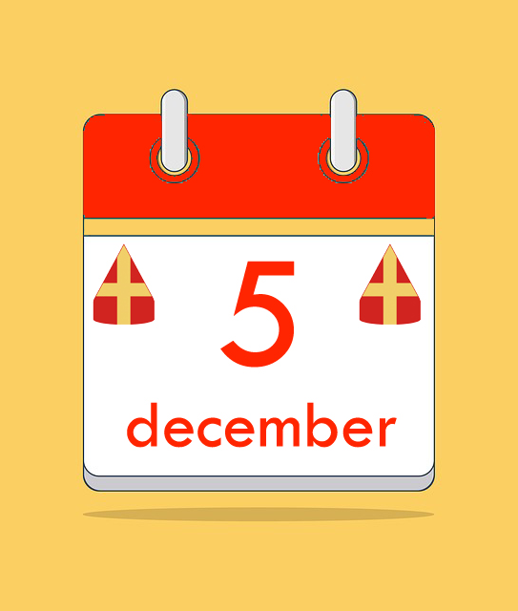
The fifth of December
When St. Nickolas comes to the country, the little children places their shoe near the fireplace or window. In the middle of the night the ’Chimney-Soot Helpers and St. Nickolas come to fill their shoes with candy and a present. This will happen until December 5, on that day St. Nickolas and the ’Chimney-Soot Helpers come to knock on your door to give lots of presents. They only do this if the children have been good. The naughty are ‘taken’ back to Spain.

Slide 8
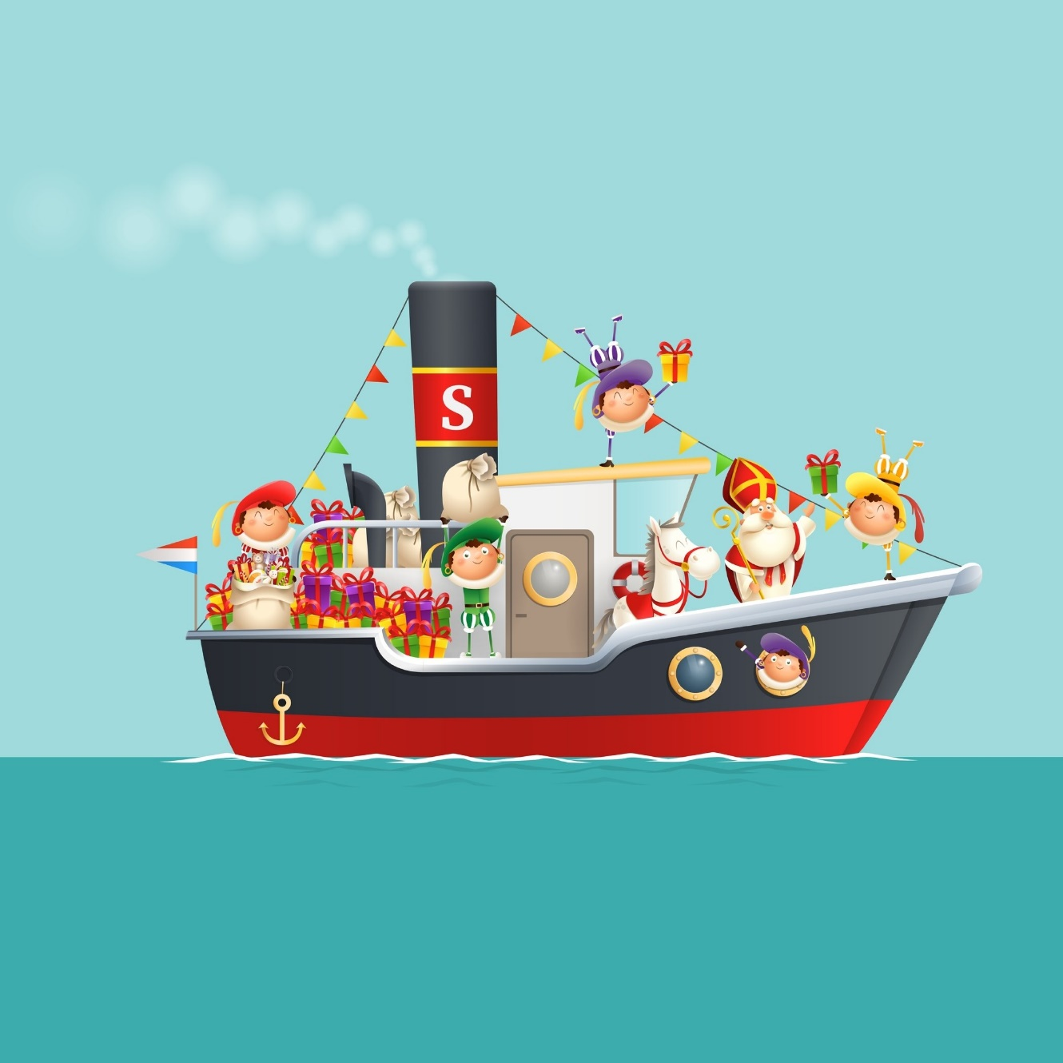
The end
We hope you learnd more about the Dutch traditions!
Greetings,
Lizzy, Eva and Maud

Slide 9
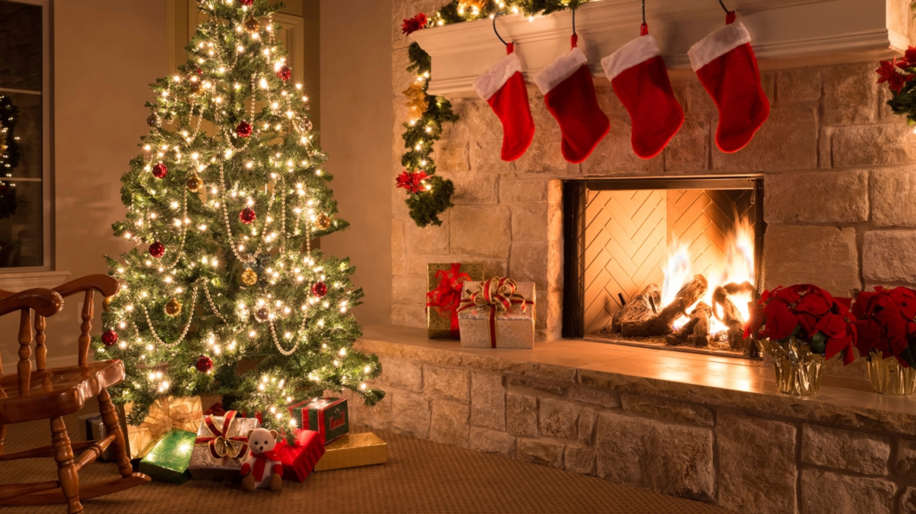
Christmas in the Netherlands
Gemaakt door Mirthe, Isis, Fiene en Roos

Slide 10
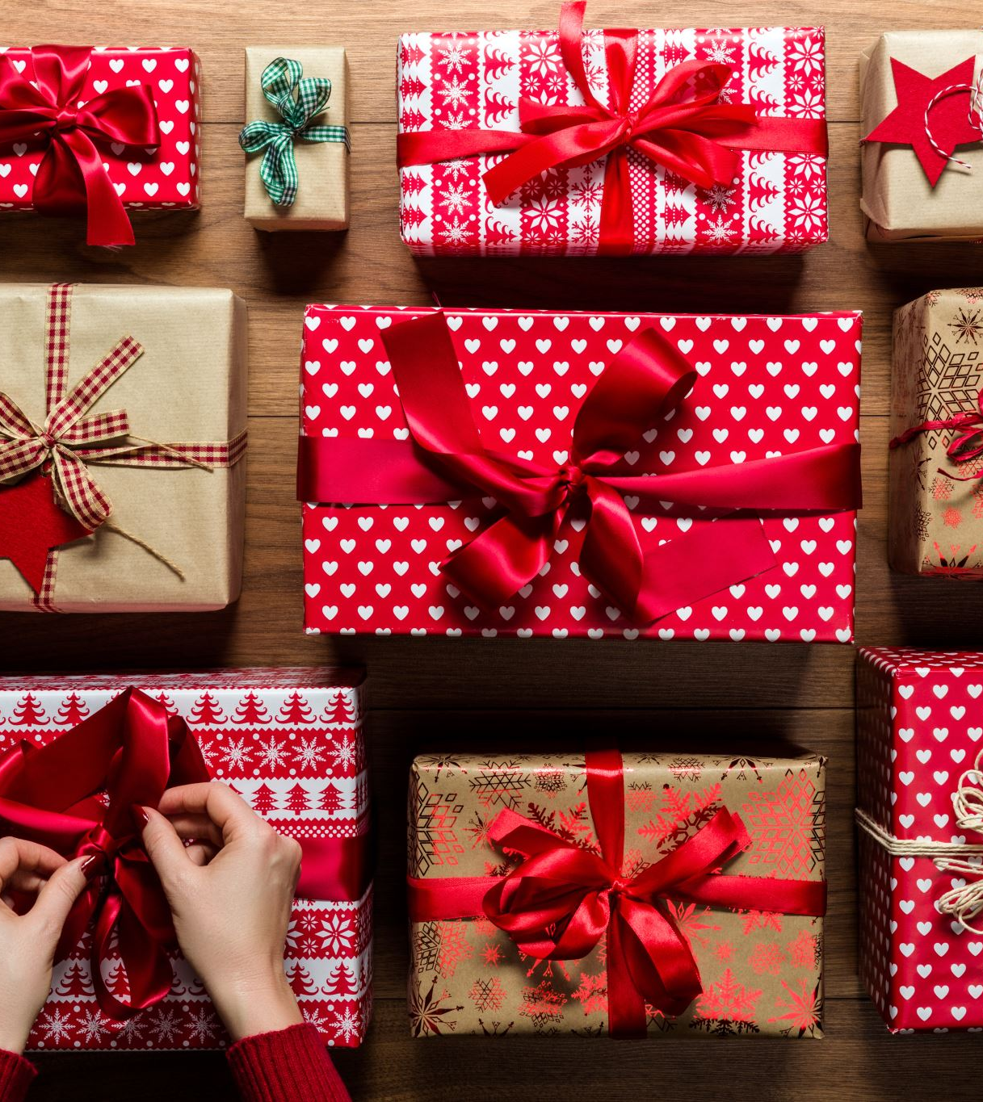
Table of contents
1. Do we celebrate Christmas in the Netherlands? And when do we celebrate Christmas in the Netherlands?
2. How do we celebrate Christmas in the Netherlands?
3. Why do we celebrate Christmas in the Netherlands? And do many people celebrate Christmas?

Slide 11
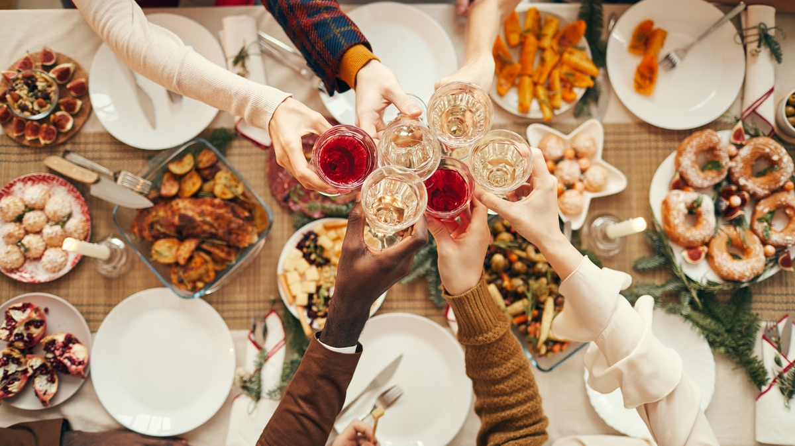
Do we celebrate Christmas in the Netherlands? And when do we celebrate Christmas in the Netherlands?
Christmas is celebrated in the Netherlands, but not as extreme as in countries such as the United States. In the Netherlands, Christmas is celebrated on December 24, when it is Christmas Eve and most people enjoy a nice meal with their family. We also celebrate Christmas on December 25 and 26, two days called Christmas Day and Christmas Day. On Christmas Day and Boxing Day we often have dinner with family and friends.

Slide 12
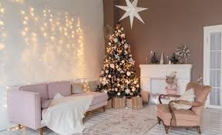
How do we celebrate Christmas in the Netherlands?
Most people in the Netherlands put up a Christmas tree and decorate the house with nice decorations. People usually start decorating the house around December 6 because that is when Sinterklaas arrives. Many people also often have an Advent calendar at home from December 1, and count down until Christmas with nice presents or tasty sweets. On Christmas itself, most people go out to eat or dine at home with family and friends. Many people used to eat rabbit or duck at Christmas, but that is becoming less and less.

Slide 13
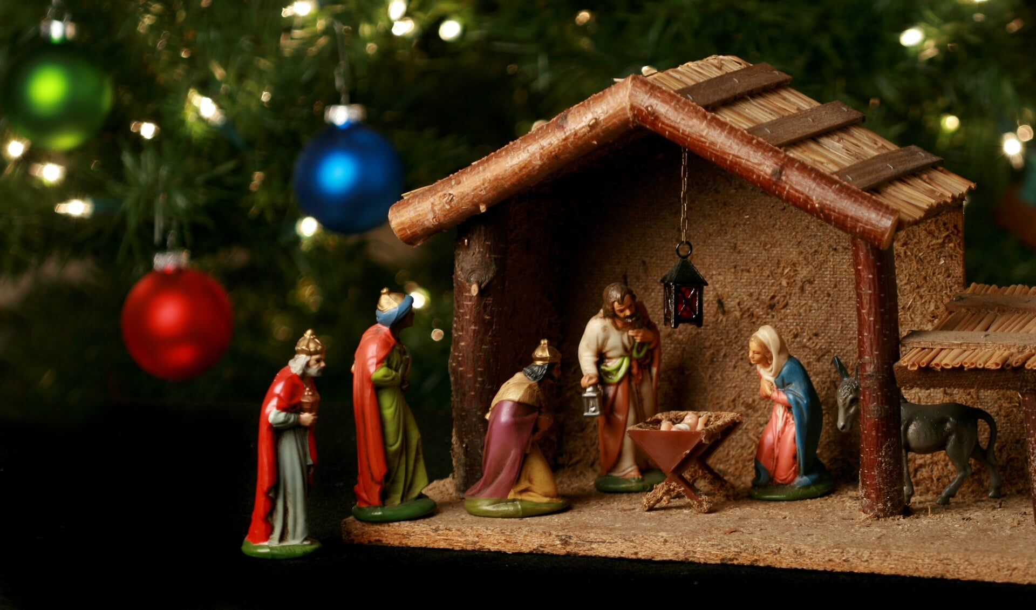
Why do we celebrate Christmas in the Netherlands? And do many people celebrate Christmas?
We originally celebrated Christmas in the Netherlands to celebrate the birth of Jesus and tell the story of his parents' journey. But from now on, this is done less and less and most people celebrate it because it is a well-known holiday and for fun. There are quite a few people who celebrate Christmas, but not everyone celebrates Christmas and Christmas is not celebrated as it is in the US, in our country there are no Christmas presents under the Christmas tree.

Slide 14
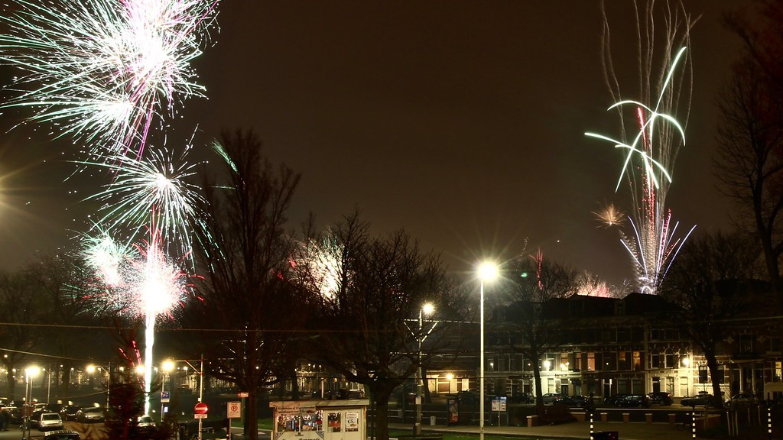
Oud en Nieuw
Made by: Joeri, Bram, Joep and Raf
Deze foto van Onbekende auteur is gelicentieerd onder CC BY-NC

Slide 15

What and When?
Oud en Nieuw is a Dutch translation for Old and New.
New Year's Eve is a Holiday that is celebrated all over the world.
Deze foto van Onbekende auteur is gelicentieerd onder CC BY

Slide 16
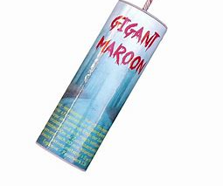
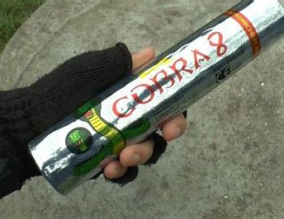
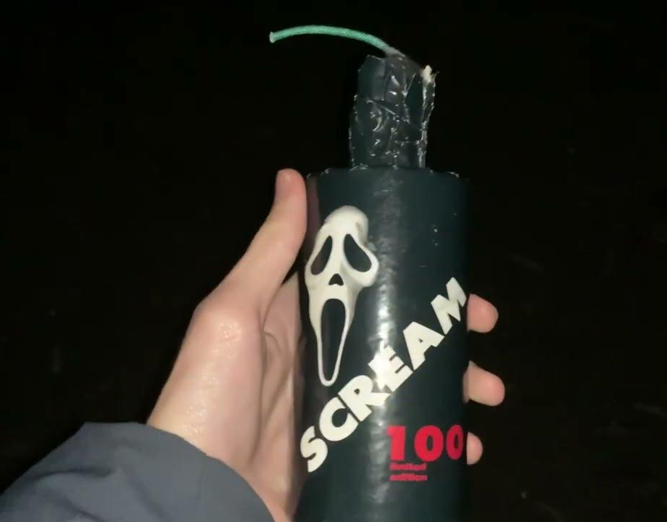
Dutch traditions….
In the Netherlands people really like fireworks and i mean REALLY like fireworks. It is so bad that every firework above cat1 is banned. So a lot of people drive to germany or belgium to get their fireworks from there. But a lot of police man are standing at the border so that people don’t smuggle eligal fireworks in the Netherlands. The most famous banned fireworks are Cobra’s and gigant Maroon and screams.

Slide 17
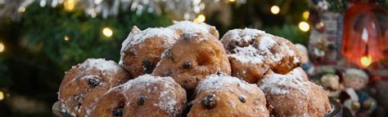
Dutch food at new years ’eve
The most famous food that dutch people eat at new years ‘eve are: oliebollen it means oil balls but thats not really what it sounds like. You can eat them with a lot of different ways like with or without currants or with or without powdered sugar etc.

Slide 18

The End.

Slide 19
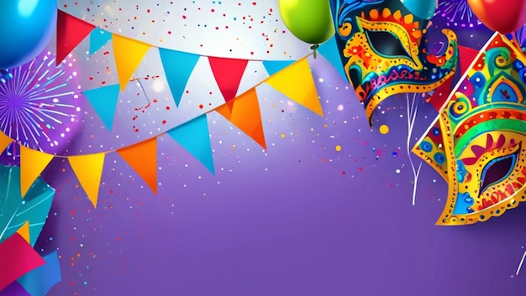
Carnival
By Jill, Fenna ,Britt and Mara

Slide 20
Content
Clothes with Carnival
Villages
Parades
Where is Carnival celebrated?
What do they celebrate with Carnival?
Music during Carnival

Slide 21
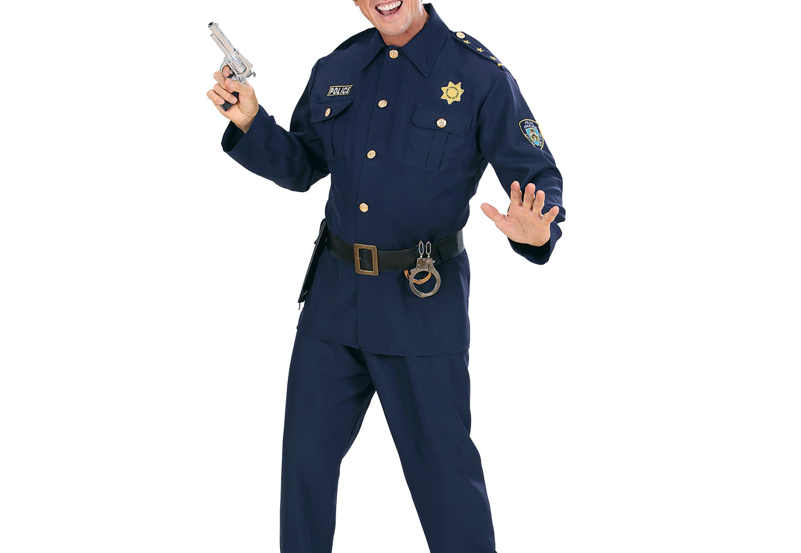
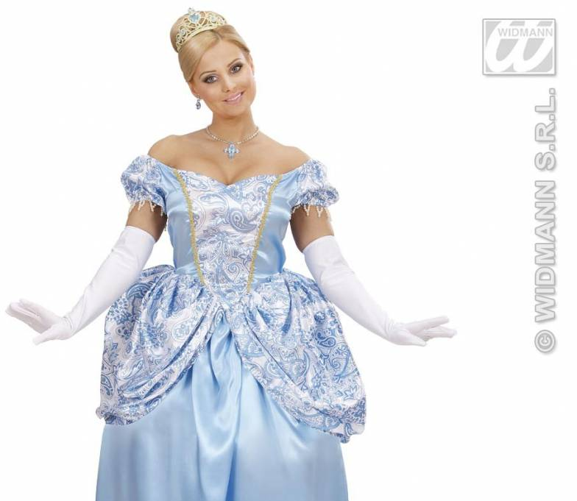
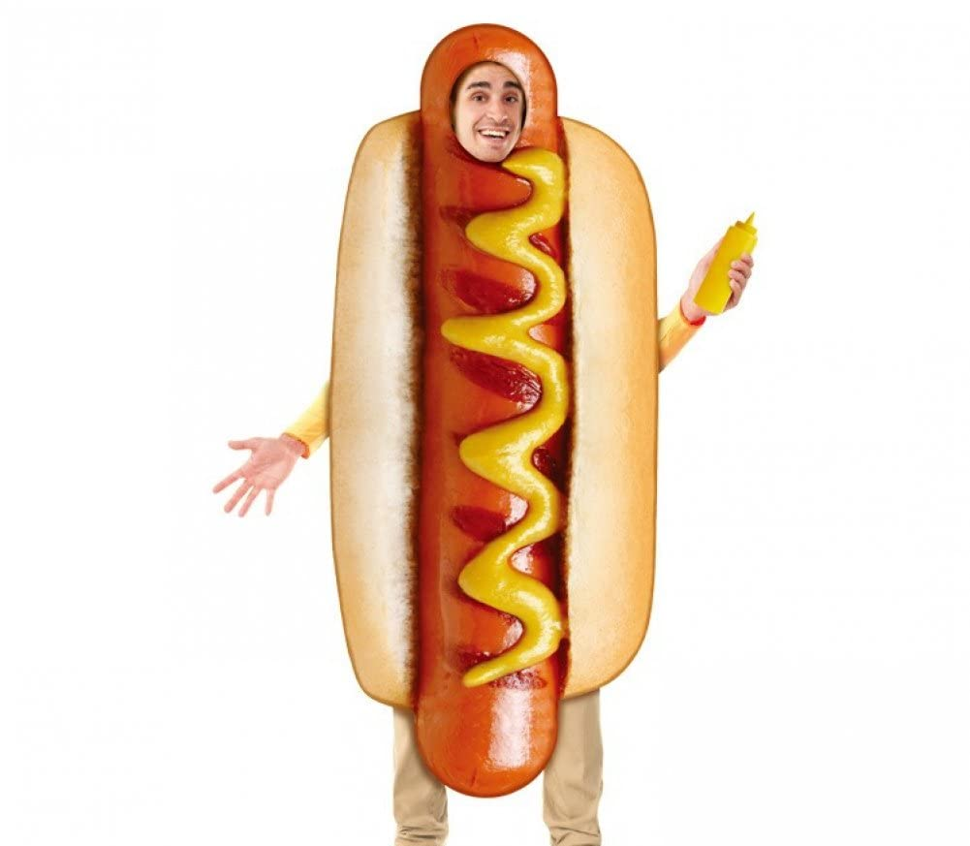
Clothes with Carnival
People can wear whatever they want on this holiday.
You can wear a hotdog costume
Or you can wear a police costume
Or a princess
You can dress up as crazy as you can.

Slide 22
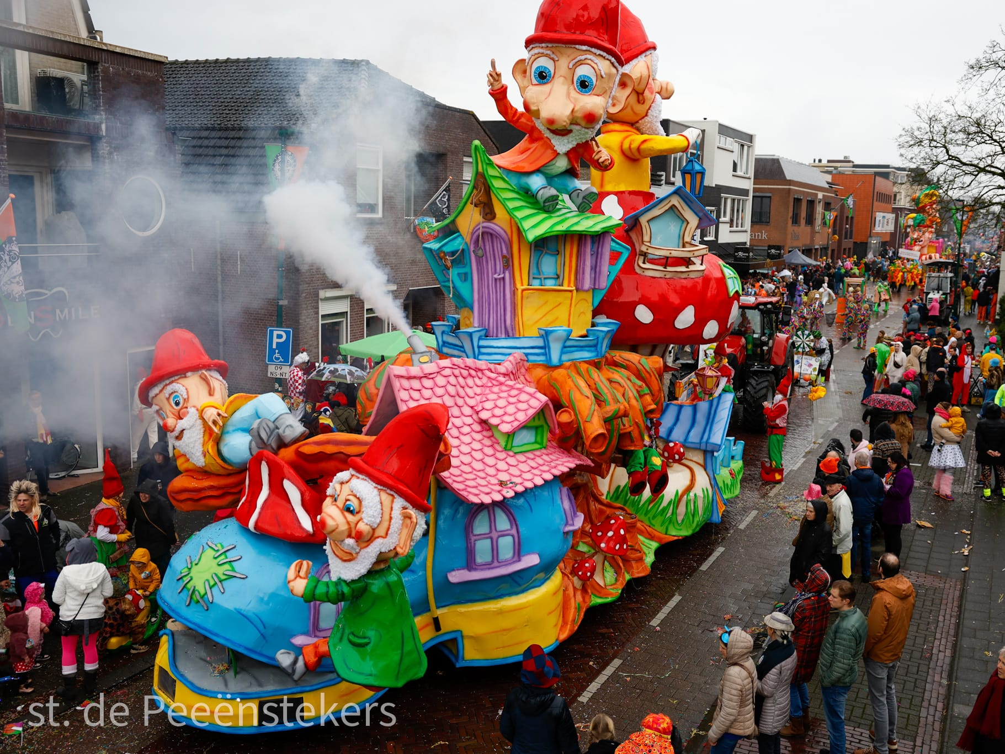
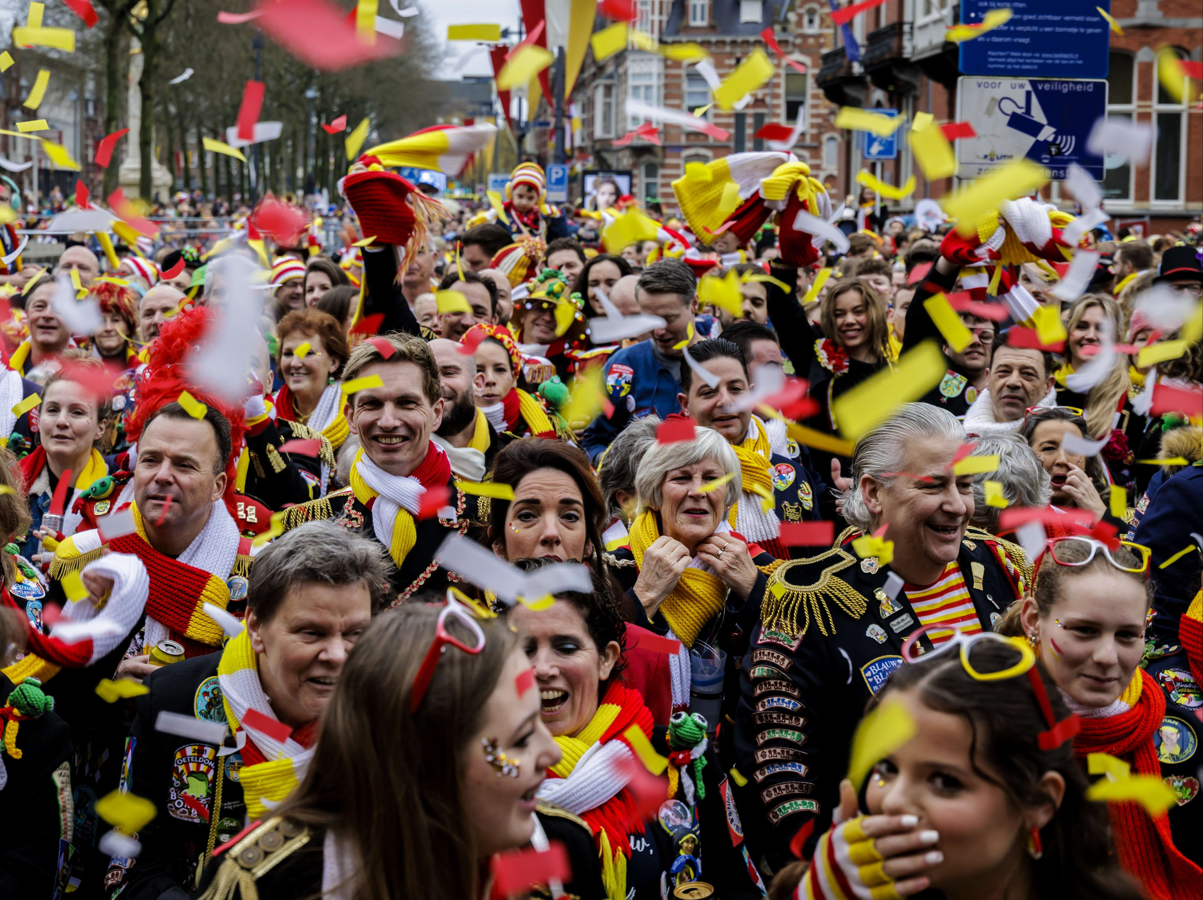
Villages
During Carnival, each village has its own unique traditions and atmosphere. From playful village names and local songs to varying parades and costume themes, the differences are striking. Larger towns often feature professional floats and a bustling vibe, while villages offer a more intimate celebration with close-knit communities and unique rituals, such as flag-raising ceremonies or local traditions. The role of the Carnival Prince and the choice of music also differ from place to place. This diversity makes Carnival a vibrant and deeply local celebration.

Slide 23
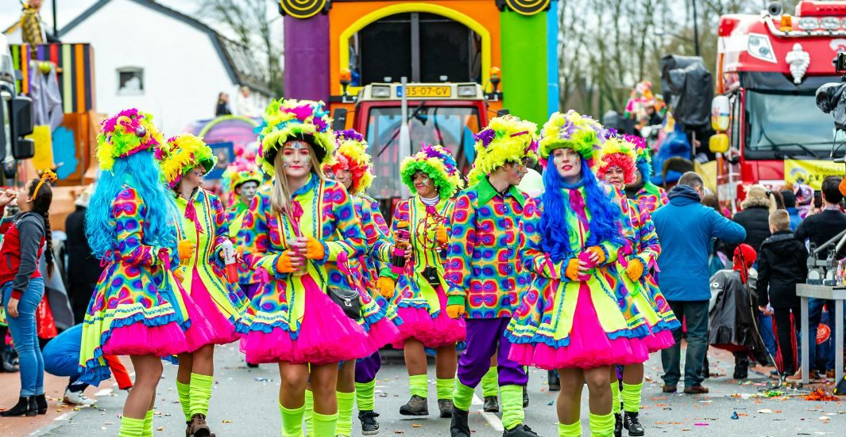
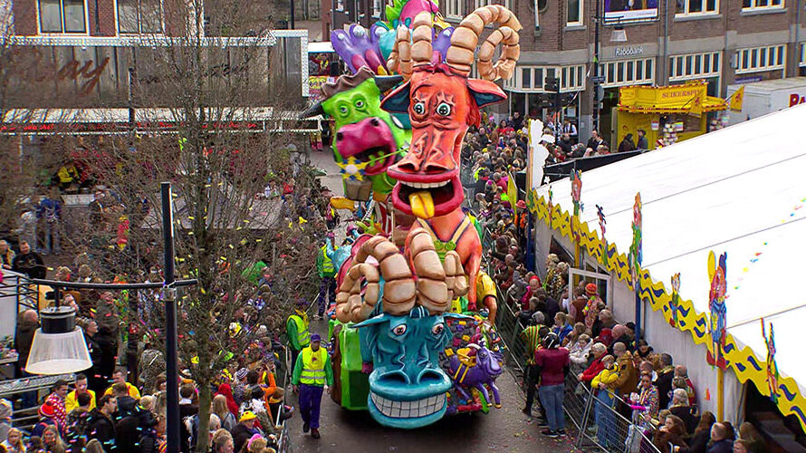
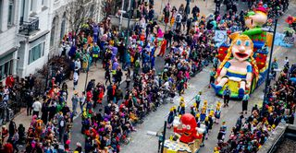
parades
During carnival people run assignments with large peace groups. With these assignments they all dress up in the same outifit with a large decorated float
The group with the most beautiful car and the nicest clothes wins and receives a cup

Slide 24
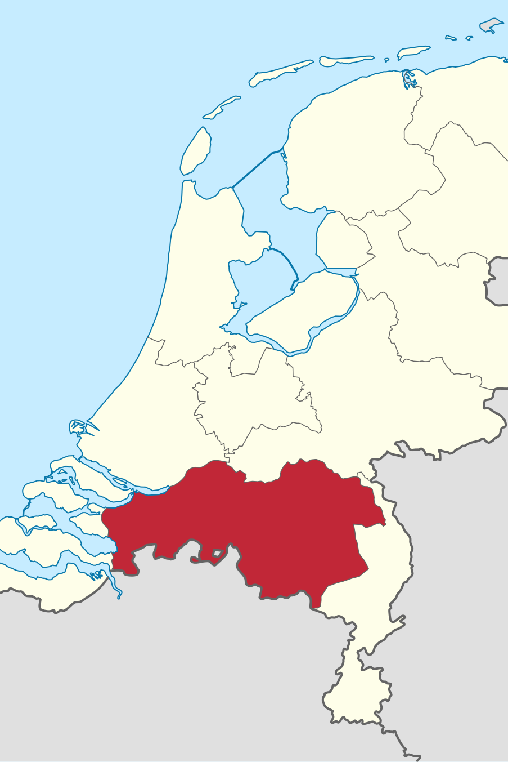
Where is carnival celebrated?
In Brabant
Carnival is celebrated in Brabant, which is in the south of the Netherlands
Up in the Netherlands it not celebrated, only in the south

Slide 25
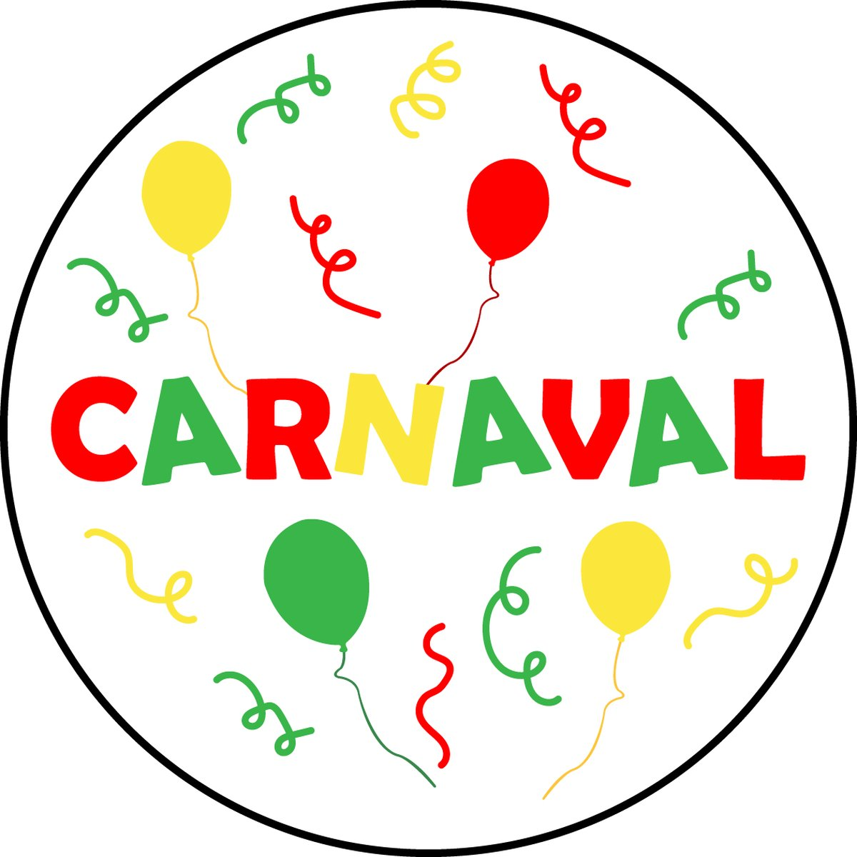
What do they celebrate with carnival?
Carnival comes from the Italian carne levare, which means something like 'the taking away of the flesh'. During Carnival we celebrate that we can go wild one last time before the austere Lent before Easter begins. Carnival used to be literally the last party before the meat was taken away.

Slide 26

what music is listened to during carnival?
some of the best known songs
https://www.youtube.com/watch?v=pFEDBewcfks
https://www.youtube.com/watch?v=eV-ITtQxEYg
https://www.youtube.com/watch?v=HCCpa5yjue0

Slide 27

The end

Slide 28
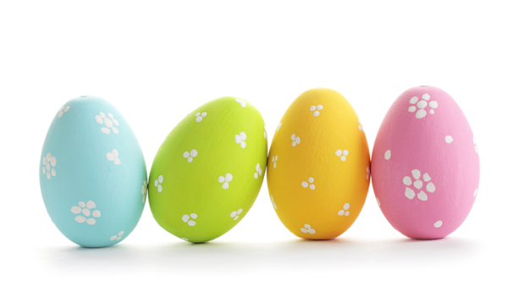
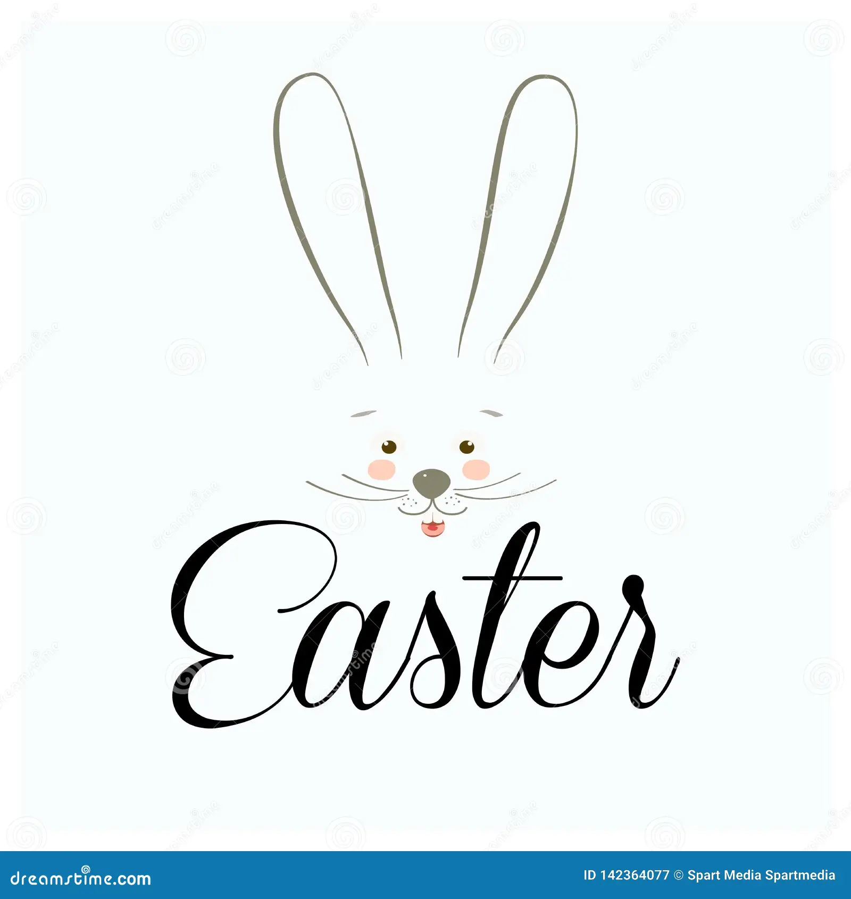

Slide 29
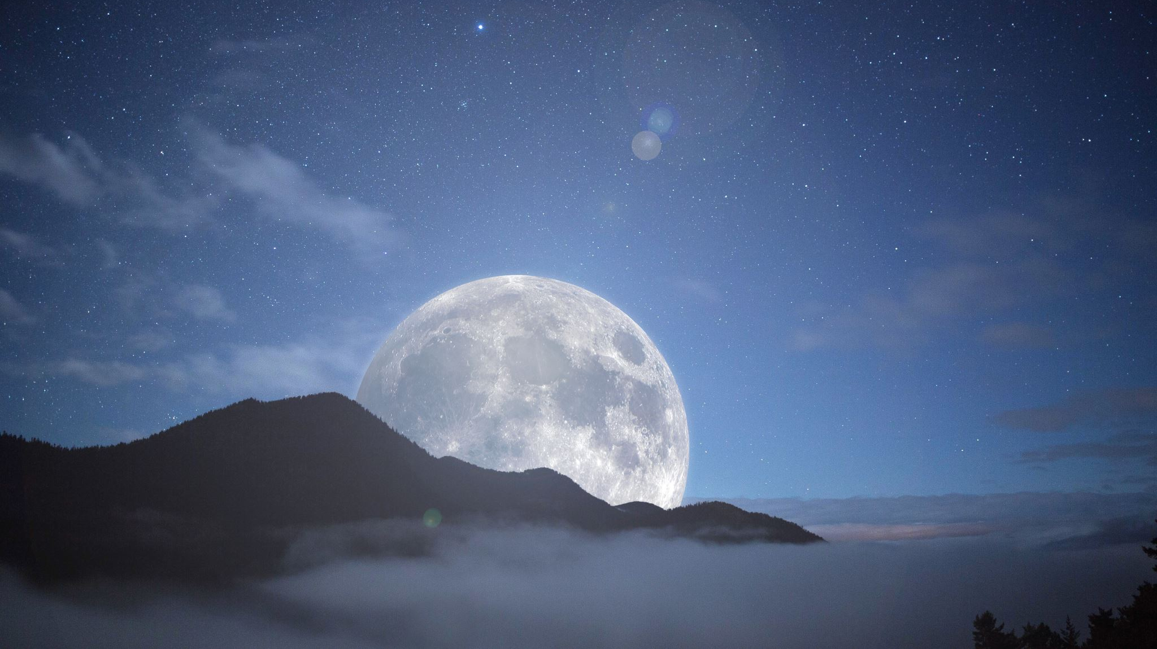
When is it
When eastern is. is every year diffrent the christians looks at the moon and decide when it is.
This year is it on 20 April 2025

Slide 30
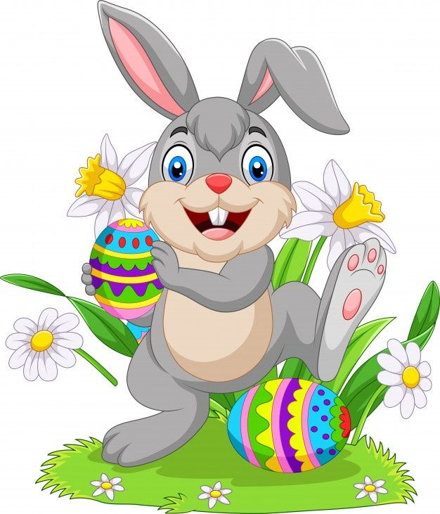
The story
It's about a hare that brings eggs. The children have to go and find the eggs. Most families have a meal together.
That is what we do as non-believers but the believers do it like this: Many Christians go to special church services on Easter Sunday. These services are often festive, with music and candles.

Slide 31
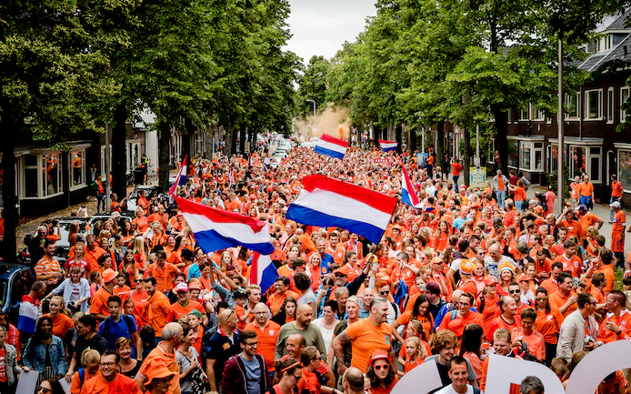
Koningsdag
Made by: Danica, Dyara, Amelia and Weronika

Slide 32
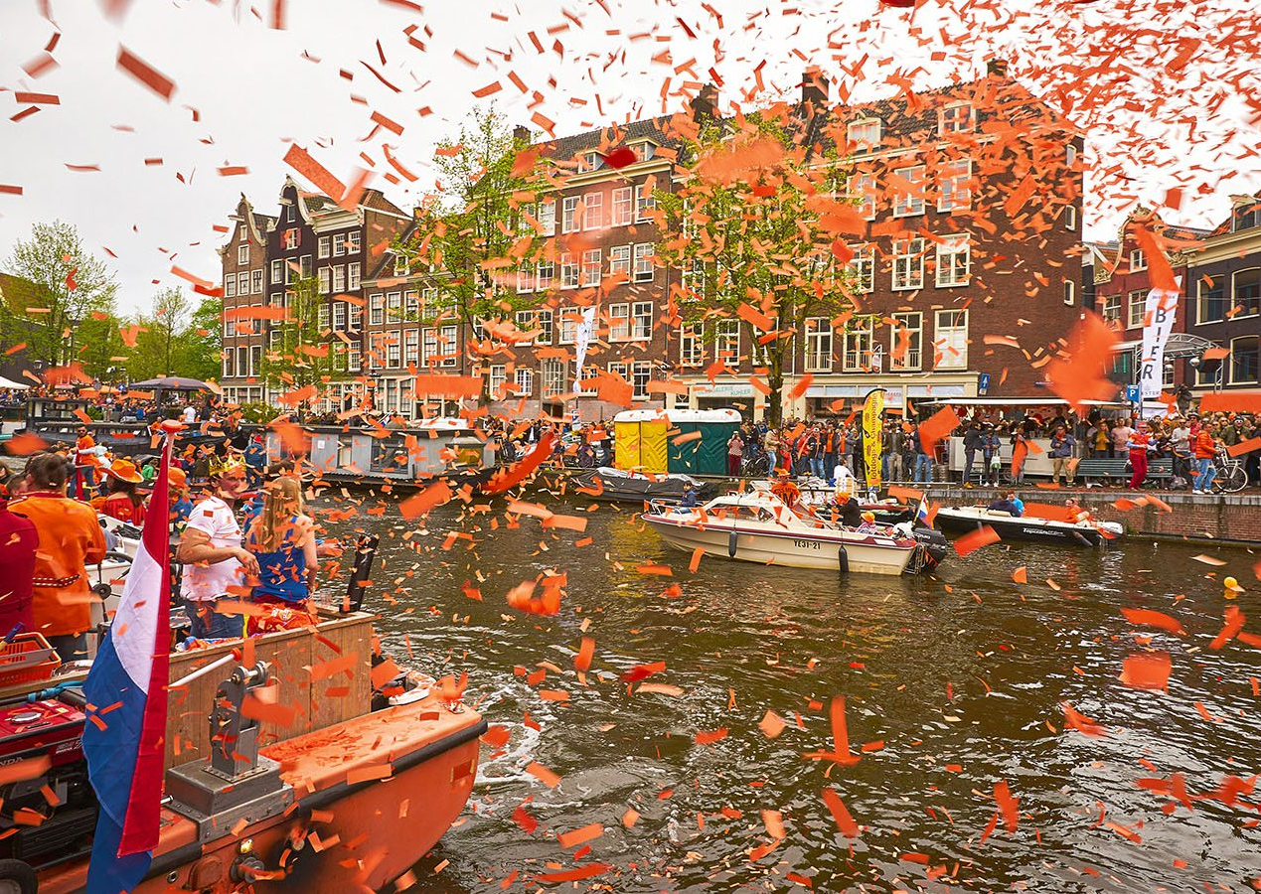
What is Koningsdag?
It is when it is the birthday of the king. That is now Willem-Alexander, but soon his daughter Catharina-Amalia der Nederlanden.
It started on 31 of august in 1889 in honor of Princess Wilhelmina's birthday.

Slide 33
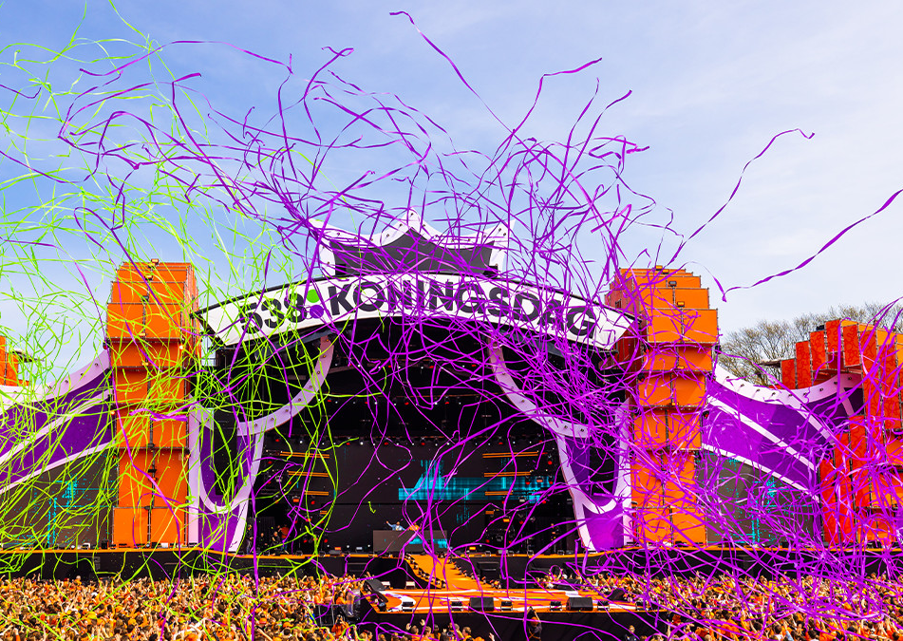
What do you do on Koningsdag?
There is a big party where the royal familie comes to.
In the big cities such as Amsterdam there are activities as a big concert where many popular people perform or some markets where people sell stuff.
In some smaller villages there are some local activities to maybe do with your neighbors.
But one sure thing, there is always playing music to honor the Netherlands and celebrate the king's birthday.

Slide 34
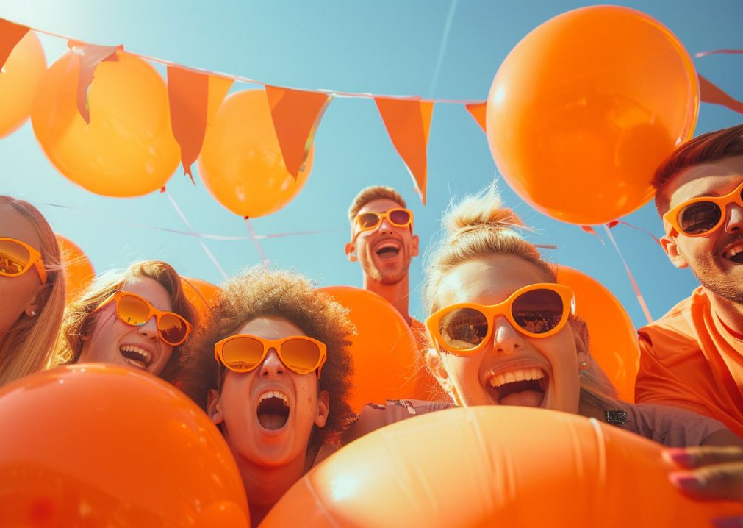
Why the colour orange?
This is because the royal family bears the name “House of Orange” (Huis van Oranje) and as a result it has become the national colour.
The colour Orange has been in the Netherlands since 1806-1810 but came back in 1813, because the Netherlands regained their independence after the incoporation of the French.

Slide 35
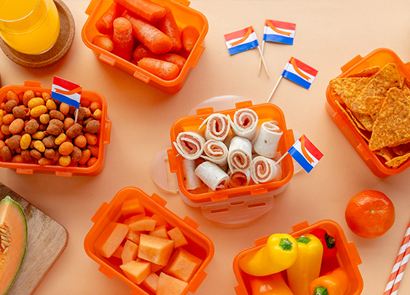
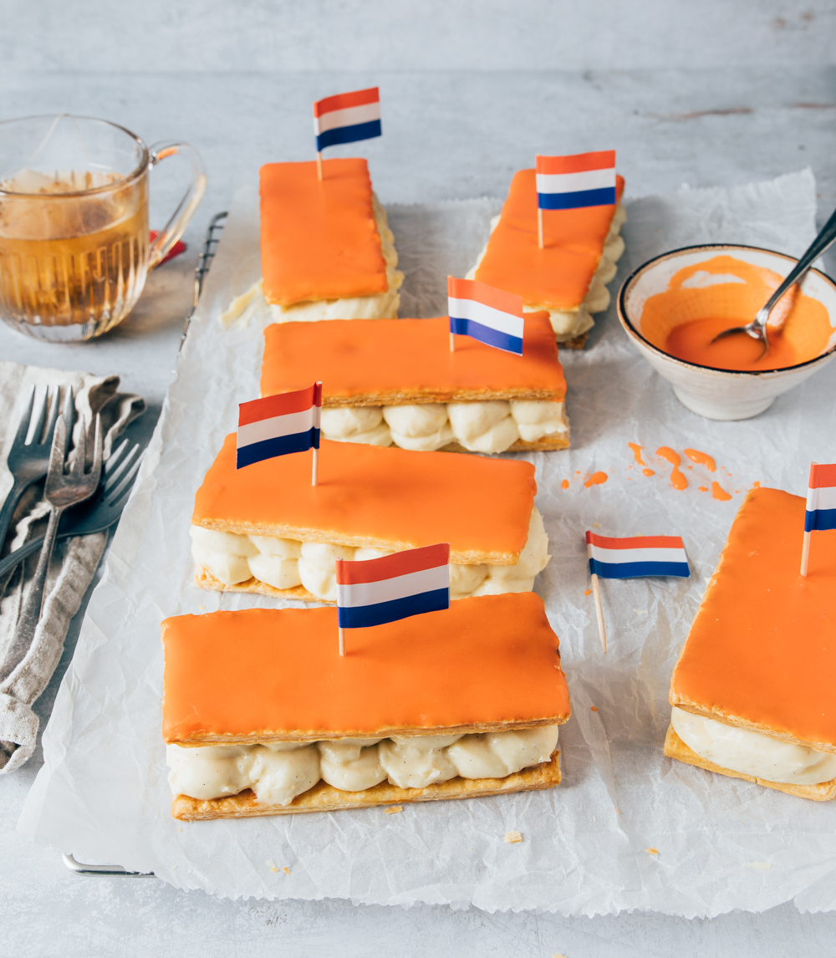
What do you eat on Koningsdag?
On King's Day, a unique occasion, it is great to celebrate with special food. Why not opt for something orange? You can choose from orange or carrot cakes, quiche with orange and salmon, but tompouce is our favorite choice. Because there is no traditional food to this holiday we mostly just eat orange food but as already said our favourite choice are the orange tompouce.

Slide 36
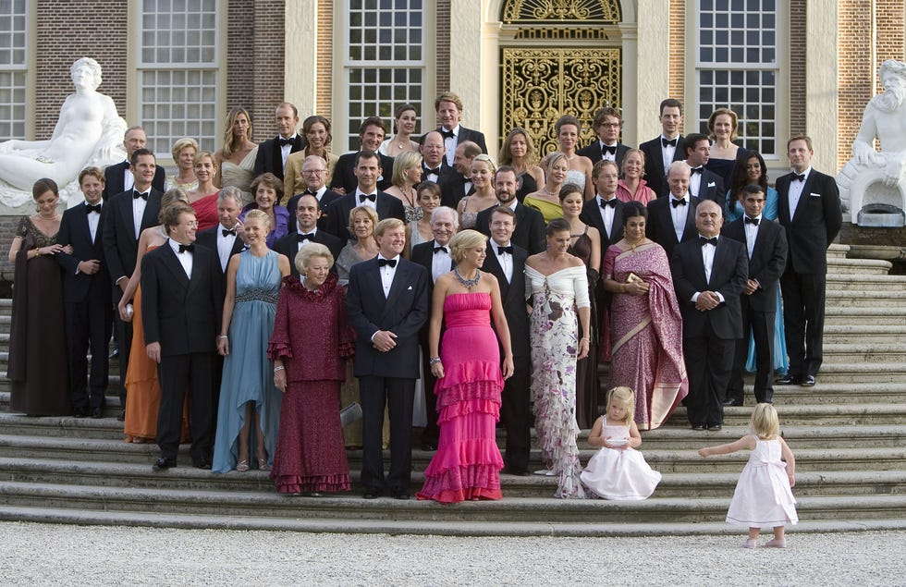
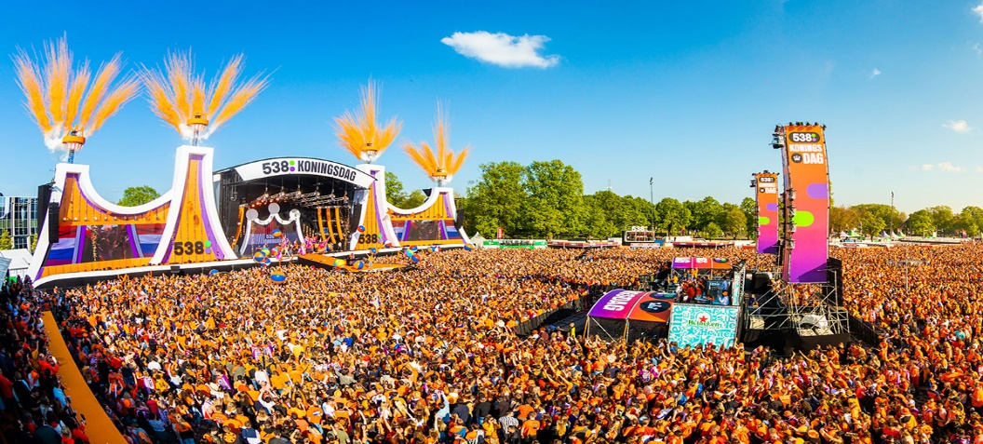
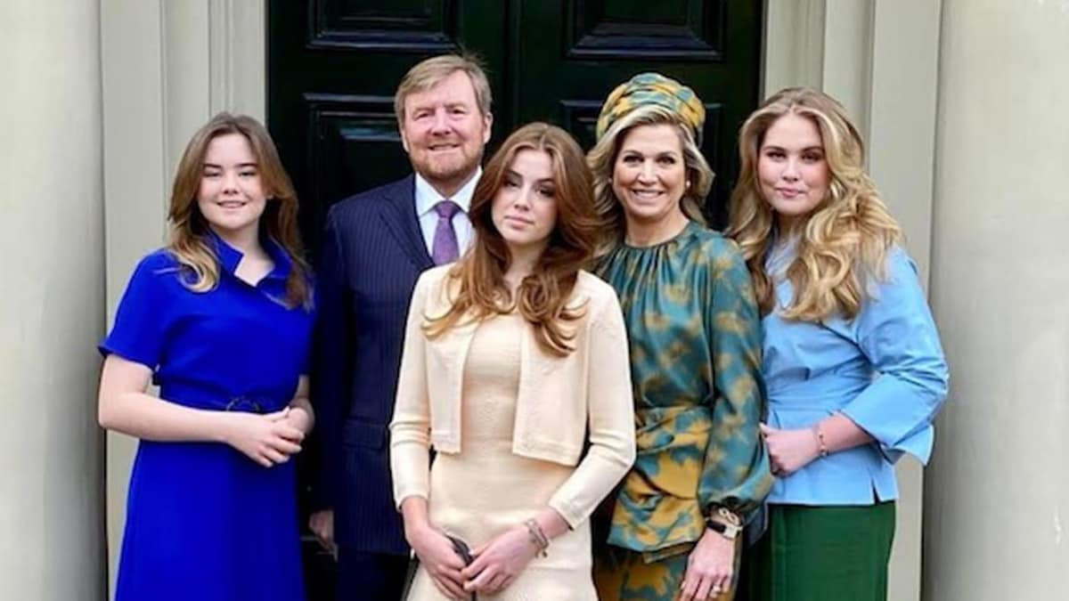
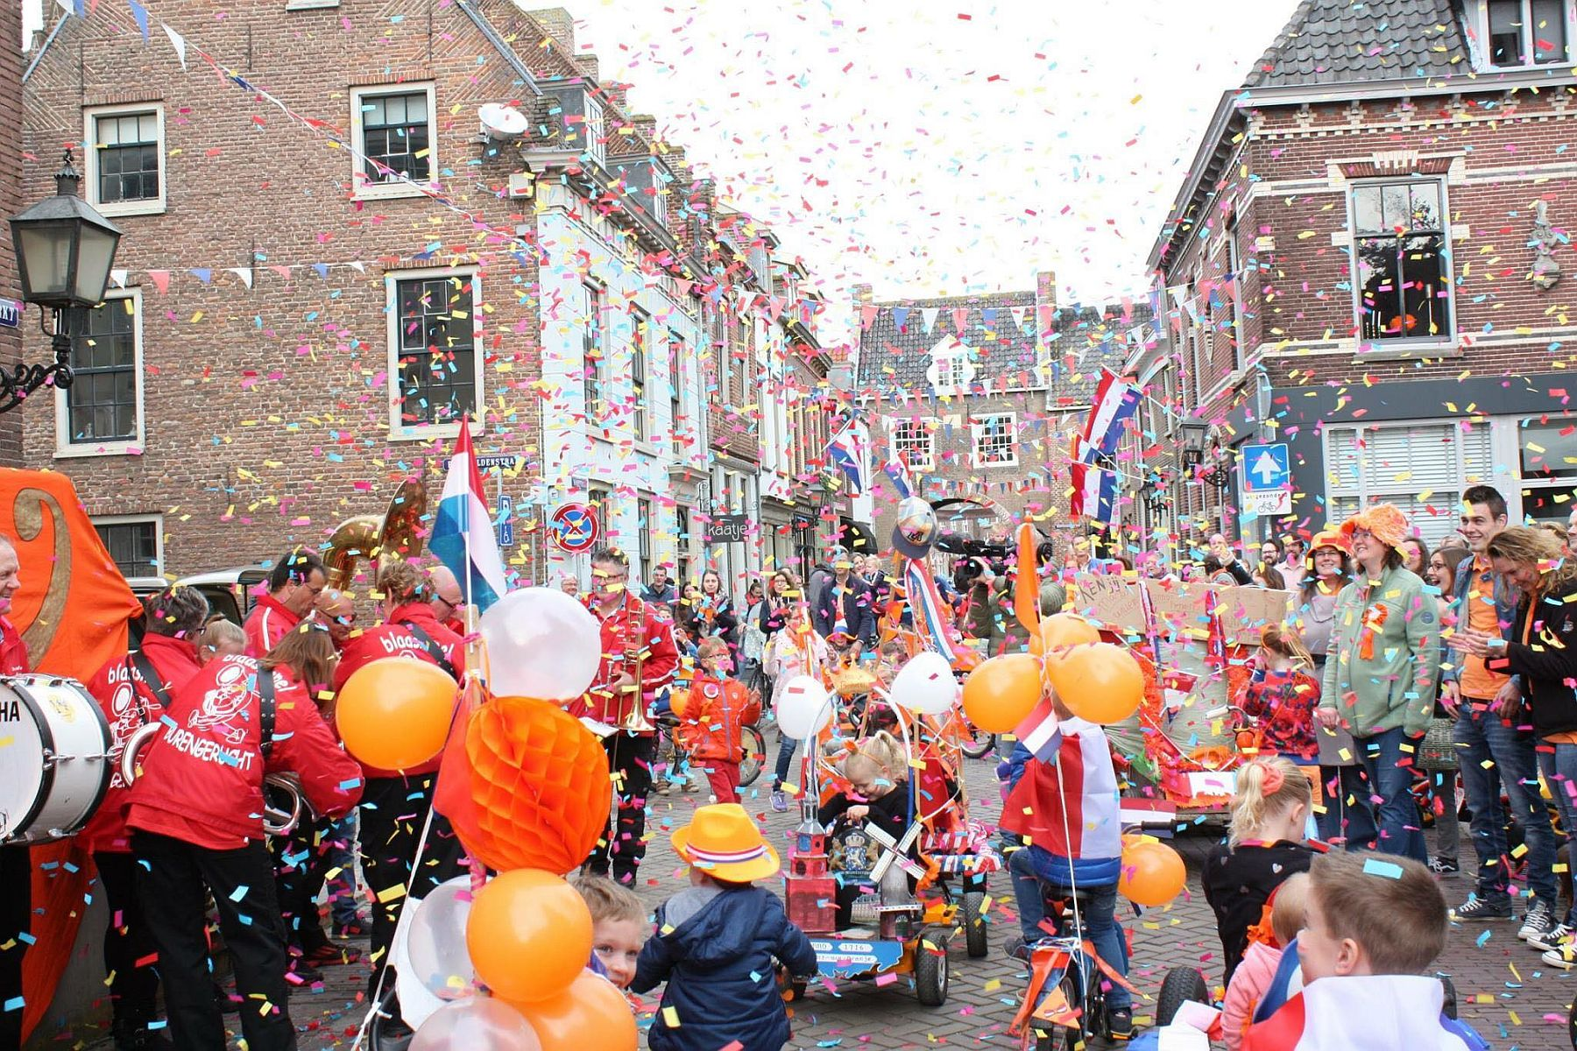
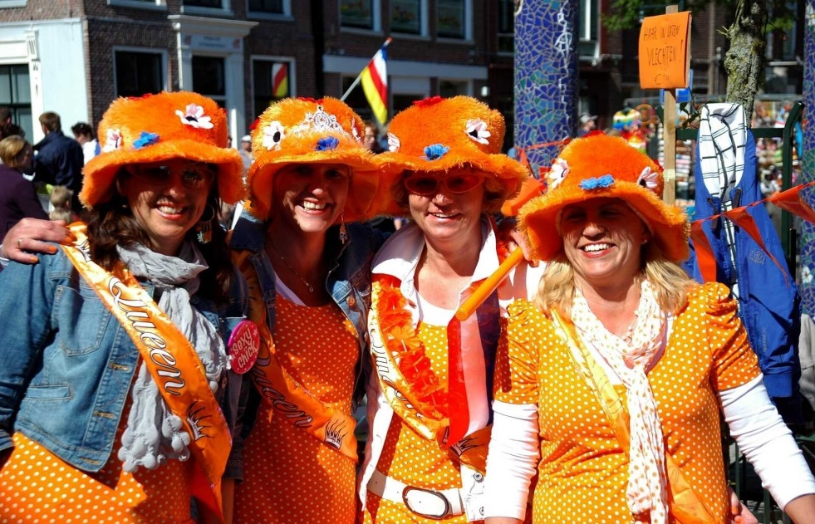
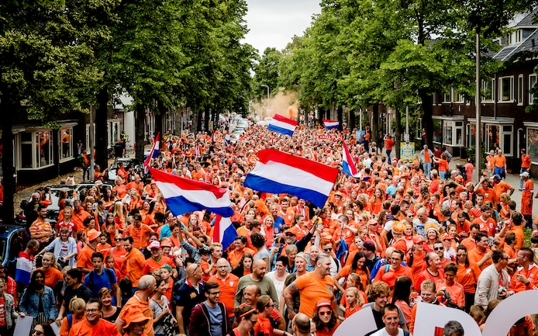

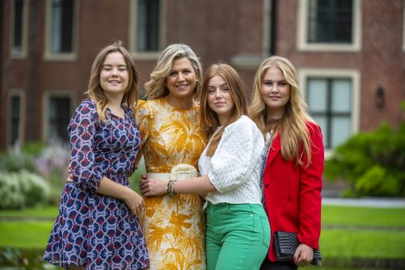
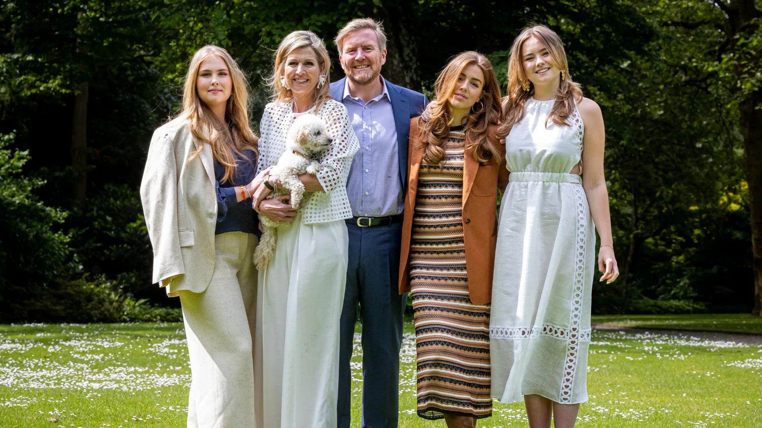
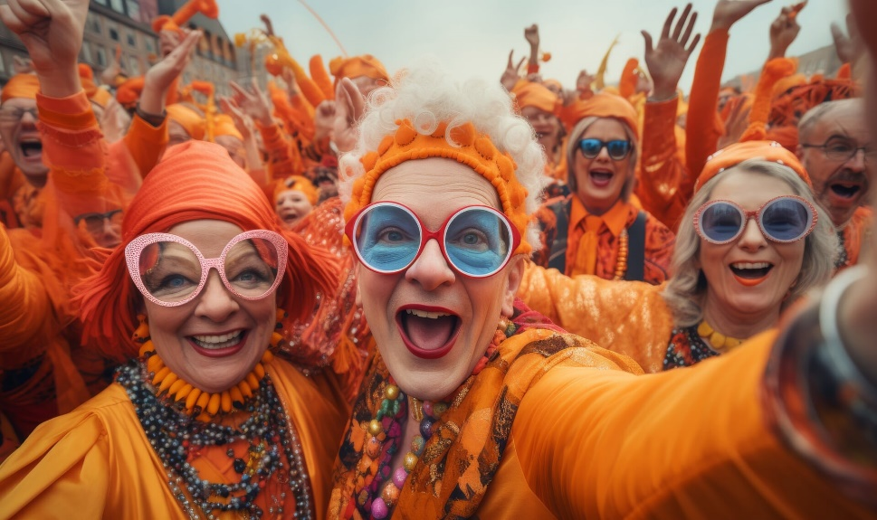
THE END

